Slide 1
Water Sector Trust Fund
How does the Sanitation Team apply for the NEMA Waste Transportation Permit (license)?
Version:2.0 Last Update: August 2017

Slide 2
Step 1
Obtain application forms either from the District Environment Officer (DEO) or downloaded from the National Environment Management Authority (NEMA) website.
☺ All the forms are available in the WSTF website: www.waterfund.go.ke
We shall also distribute the forms to you today!
Notes:
NEMA- No link
WSTF-No link

Slide 3
Step 2
Fill application forms in triplicate and attach the necessary documents
!!! This is very important? If you are not sure whether you have filled it in properly, inform your contact person at the water company. They will help you! Don't worry ☺

Slide 4
Step 3
Pay prescribed application fee through NEMA’s Kenya Commercial Bank (KCB) Revenue Account (233971386) or Cash payment of Kshs 3,000 at NEMA headquarters. NEMA official receipt will be issued on evidence of payment such as bank deposit slips or copy of banker’s cheque.
3000 shillings is the application fee and is a one of payment! ☺

Slide 5
Step 4
Return the duly filled application forms and documents to the NEMA Regional Office.
They will then forward them to the NEMA Headquarters, waste management section for reviewing.
☺ Inform your contact person at the water company once you hand in your documents so that we can follow up at the NEMA Regional Office!

Slide 6
Step 5
The application will then be reviewed within 21 working days. An approval for licensing will be given with relevant conditions or a decline stating the reasons.
☺ Don’t worry, As long as you have filled in the application form completely, all will be well. NEMA is aware of the UBSUP programme and are happy with the important work that you will be doing! ☺

Slide 7
Step 6
Upon fulfilment of application requirements and payment of license fees, a license will be issued within 30 working days
☺ Finally the license is out! Time to start working!!

Slide 8
Step 7
The license is renewed annually upon adherence to all conditions provided.
☺ Don’t forget to renew your licenses please!

Slide 9
NEMA Charges
NOTE!! Application Fee charges a) Transportation of waste KSh 3,000
Licensing fee charges a) Transport waste KSh 5,000

Slide 10
NEMA Tracking document
1. Serial number: Each tracking document to have a serial number starting with 001 2. Number should never be repeated 3. Registered name of transporter as per the licence is required 4. Usual area of operation as per the licence is required 5. License number as per waste transportation licence issued by NEMA
LET US PRACTICE TOGETHER TO FILL IN THE TRACKING DOCUMENT! (Copies to be distributed)

Slide 11
Application for licence for transport (Guidelines) (1)
Attach application fee receipt/ bank slip
Copy of the certificate of registration
Attach a copy of the lease agreement or memorandum of understanding from the water company for the SaniGos
State the type of SaniGo (motorised or non-motorised)
Provide 2 photographs of the vehicle (front and side/rear view) showing the vehicle is appropriately labelled

Slide 12
Application for licence for transport (Guidelines) (2)
Submit a valid copy of drivers license
Indicate amount of waste to be transported
State the type of waste to be transported
Indicate whether the disposal site is licensed by NEMA

Slide 13
Application for licence for transport (Guidelines) (3)
Provide a sample tracking document with company log in NEMA prescribed format
Provide name, designation and signature of the contact person
Put the official company stamp on the application form
Application fee is Ksh 3000 License fee is Ksh 5000
All payments to be made to NEMA revenue account 1102298158 KCB Bank KICC Branch

Slide 14
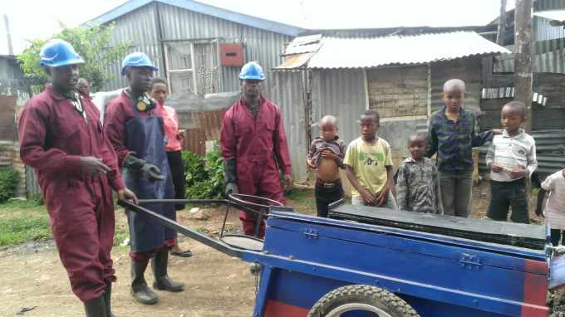
Thank you! Any questions??

